Slide 1
Rectifiers, Filters and Regulator

Slide 2
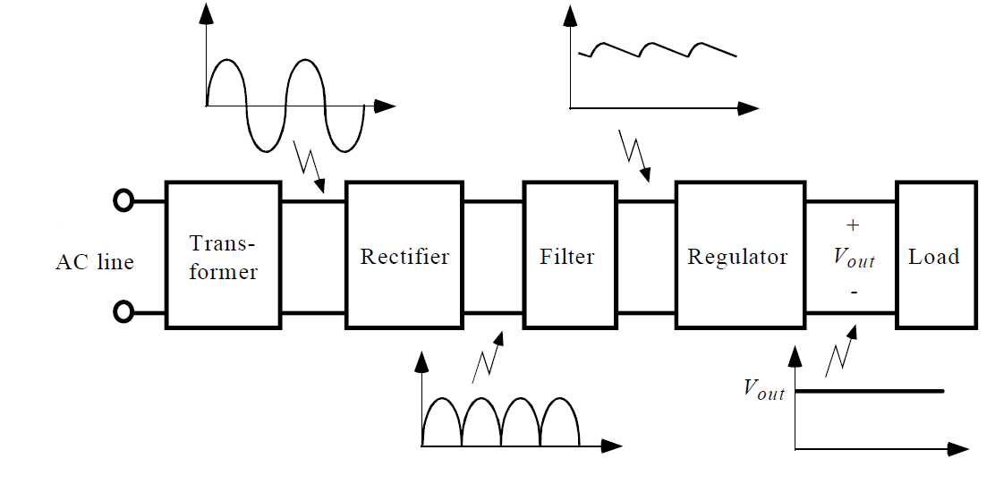
Basic Block Diagram of Regulated power Supply

Slide 3
The block diagram of a regulated de power supply is as shown in Fig below
The basic building blocks of a regulated de power supply are :
A step down transformer
A rectifier
Filter
Voltage regulator
3. Description :
The AC mains voltage is applied to a step down transformer. It reduces the amplitude of ac voltage and applies it to a rectifier.
The rectifier is usually bridge type full wave rectifier. It
converts the ac voltage into a pulsating de voltage. The ripple in the pulsating dc is reduced by the filter which is connected after the rectifier.
The filter can be C type, L type, LC type or CLC type. The output or the filter is a smooth dc voltage with a small ripple. The combination of transformer, rectifier and filter is called as the unregulated power supply.
The output of the unregulated power supply is connected at the input of the voltage regulator circuit. The voltage regulator is a specially designed circuit to keep the output voltage constant.
Even though the output voltage V, of the regulated power supply remains absolutely constant, practically it does not remain absolutely constant. It changes slightly due to changes in certain parameters, such as load current, input voltage or temperature.
Thus we get a constant de voltage at the output of the regulated dc power supply.

Slide 4
Waveforms:
Fig shows waveforms at different points in a regulated power supply.

Slide 5
Rectification
Rectification is a process of converting the alternating quantity (voltage or current) into a corresponding direct quantity(voltage or current).
The input to a rectifier is AC whereas its output is unidirectional or DC.

Slide 6
Rectifiers
Rectifier is an electronic device which is used for converting an alternating quantity (Voltage or current) into unidirectional i.e. DC quantity (Voltage or current).
Block diagram of Rectifier:

Slide 7
Need of Rectification
Every electronic circuit such as amplifiers, needs a DC power source for its operation.
This DC voltage has to be obtained from AC supply.
For this the AC supply has to be reduced (Stepped down) first using a Step down transformer and then converted to dc by using rectifier.

Slide 8
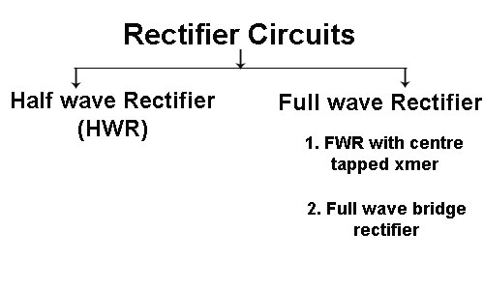
Types of Rectifier

Slide 9
Half Wave Rectifier
In this, the rectifier conducts current only during the positive half cycles of input AC Supply.
During negative half cycles, there is no flow of current and hence no voltage drop across the load.

Slide 10
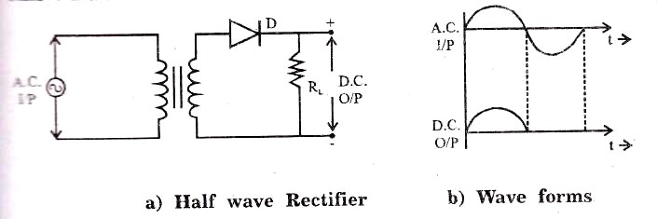
Half Wave Rectifier
Vs
IL
Transformer

Slide 11
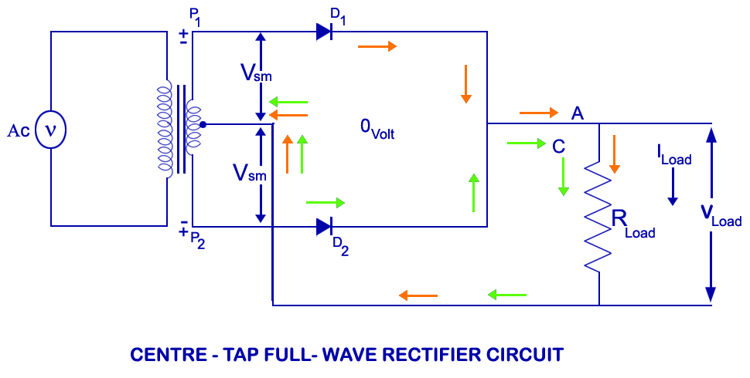
Full Wave Rectifier (Center Tapped Transformer)

Slide 12
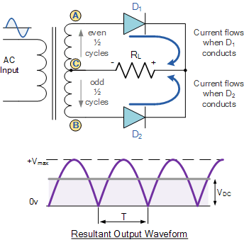

Slide 13
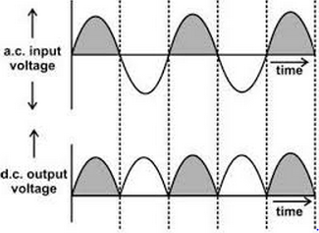

Slide 14
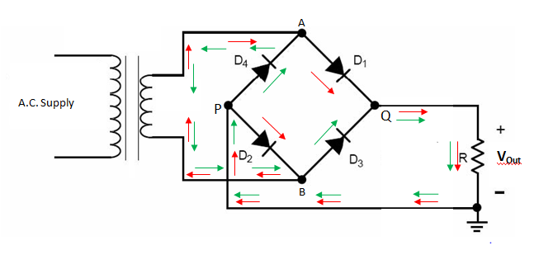
Full Wave Rectifier (Bridge)

Slide 16
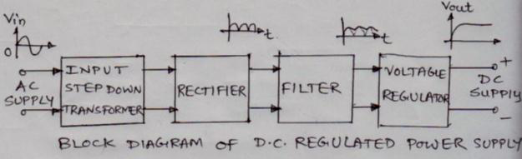
Block diagram of regulated power supply and state its need.

Slide 17
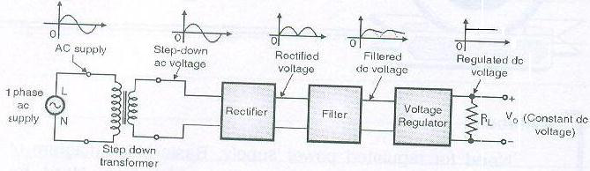

Slide 18
Need of regulated power supply
The unregulated D.C. power supply suffers from the disadvantages of poor voltage regulation and high ripple factor.
This may result the erratic operation of most of the electronic devices and circuits and also electronic gadgets such as pocket radios, electronic calculators, digital watches/ clocks, tape recorders etc.
In order to avoid erratic operations of electronic circuits and also to improve voltage regulation and ripple factor, there is necessity of regulated D.C. power supply.

Slide 19
Rectifier
Def-Rectifier the circuit in which convert the alternating(AC) voltage or current into unidirectional direct(DC) voltage or current.
Types of rectifier circuits
1. HWR(half wave rectifier)
2.FWR(full wave rectifier) with center tapped transformer.
3. FWR with bridge rectifier.

Slide 20
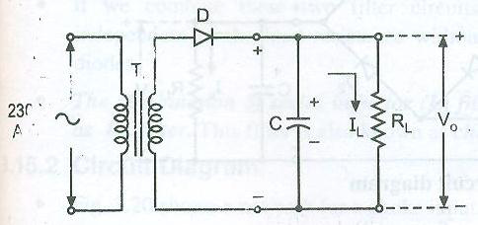
half wave rectifier with shunt capacitor filter.
Circuit diagram of half wave rectifier with shunt capacitor filter

Slide 21
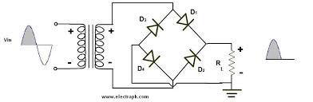
Bridge type full wave rectifier.

Slide 22
Working:
1) In this circuit four diodes are used which form a bridge, an ordinary transformer is used.
2) In the +ve half cycle D1, D4 hence current flows through D1, RL and D4.
3) In the –ve half cycle D2, D3 hence current flows through D1, RL and D4.
4) In both the cases current passes through the load resistor in the same direction.

Slide 23
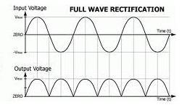

Slide 24
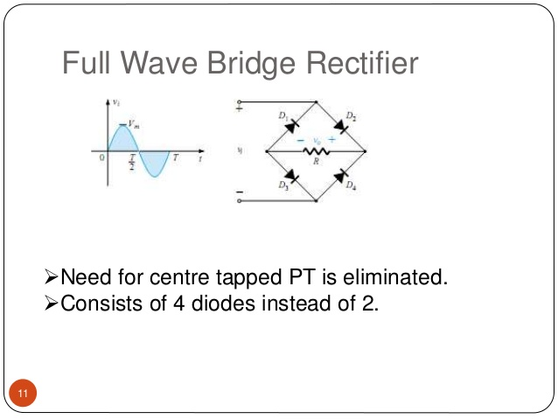

Slide 25
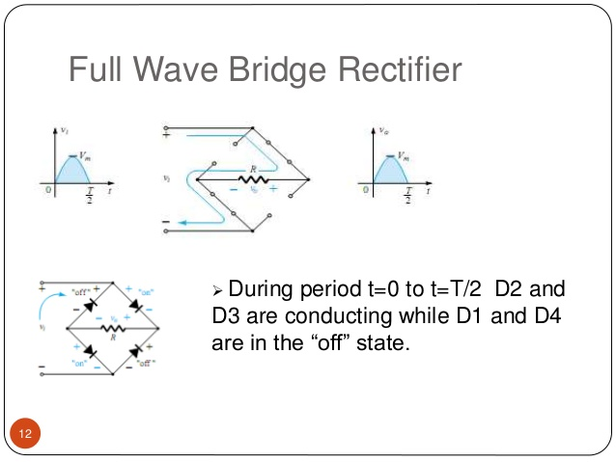

Slide 26
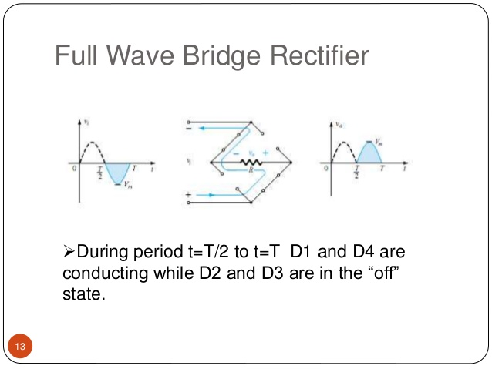

Slide 27
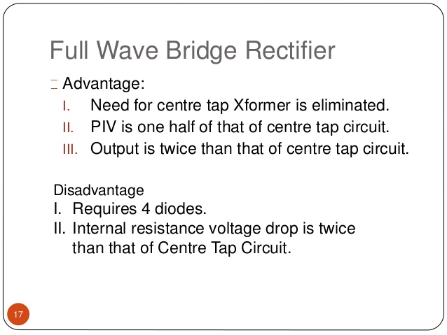

Slide 28
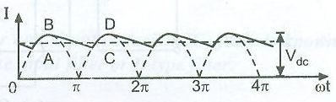
Input and Output waveforms

Slide 29
The types of filter.
Filters are classified depending on the components used and depending on the configuration in which they are connected.
Some of the important types are as follows:
1. Capacitor input filter (shunt capacitor filter)
2. Choke input filter (series inductor filter)
3. LC filter
4. π type filter OR CLC filter
5. RC filter.

Slide 30
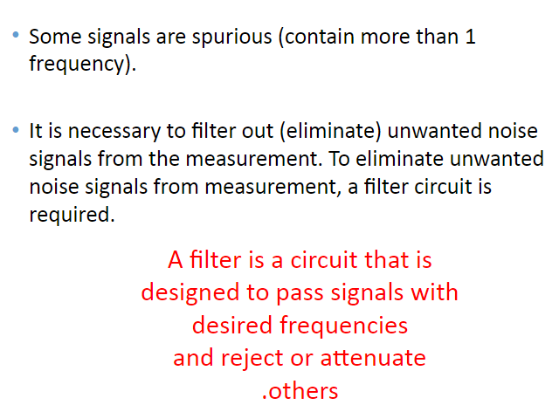
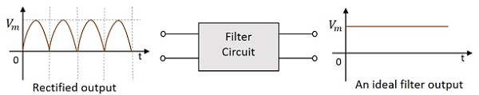
Filters

Slide 31
Types of Filters
Filters are classified depending upon the components used and depending on the configuration in which they are connected.
Capacitor input filter(shunt capacitor or C filter)
Choke input filter (series inductor filter)
LC filter
Pi filter
RC filter
The LC filter has the best performance of all these.

Slide 32
Capacitor input filter(shunt capacitor or C filter)

Slide 33
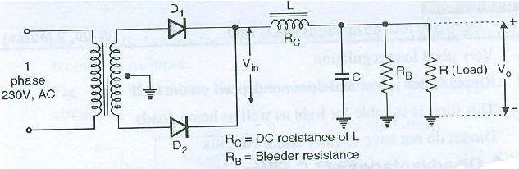
LC filter.

Slide 34
Working
The combination of series inductor (L) filter on shunt capacitor (C) filter is known as LC filter.
This filter is also known as the rectifier is applied across the input terminals of the choke input filter.
The pulsating output of the rectifier contains AC as well as DC component of current. The choke L passes the DC component from the rectifier because its DC resistance R is very small.
It opposes the AC component capacitor C bypasses AC component that presents at the output of inductor L but prevents DC component to flow through it.
Therefore only DC component reaches to the load resistor RL.

Slide 35
The need of rectification.
1.Every electronic circuit such as amplifiers needs a dc power source for its operation.
2. This dc voltage has to be obtained from the ac supply.
3. For this the ac supply has to be reduced (stepped down) first using a step down transformer and then converted to dc by using rectifier.

Slide 36
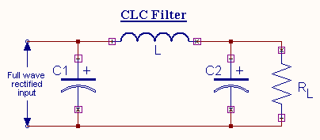
The circuit diagram of CLC filter.

Slide 37
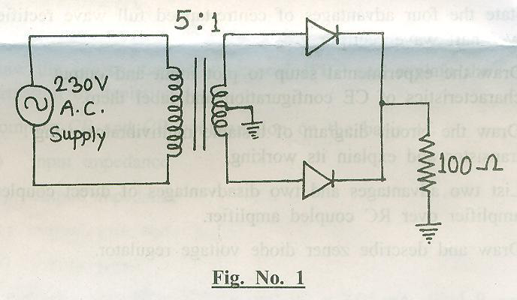
EX Following figure shows a centre tapped full wave rectifier circuit. Assuming both diodes to be ideal determine:
1. DC output voltage (Vdc)
2. Peak Inverse Voltage (PIV) of diode

Slide 38
Given: V1 = 230V
1. We know that the secondary voltage
V2 =N2/N1 x V1 = 230 x1/5 = 46 volts
Maximum value of secondary voltage
Vm = √2 x V2 = √2 x 46 = 65.05 volts
Therefore, DC voltage Vdc=Vm/π=65.04/3.14=20.71V
2.PIV of Diode = Vm = 65.05 volts.

Slide 39
An A.C. supply of 230V is applied to half wave rectifier circuit through a transformer of turns ratio 2:1 Calculate i. DC output voltage ii. PIV of diode
Given: V1= 230V N2/N1 = 1/ 2
We know that secondary voltage
V2 = N2/N1 x V1
= 230x 1/ 2
= 115V
Maximum value of secondary voltage
Vm= √ x V2
= √ x 115V
= 162.6 volts
Therefore, DC voltage
Vdc= Vm /π = 162.6/ 3.14 = 51.7 volts
2. PIV of diode
PIV of diode = Vm= 162.6 volts

Slide 40

Definition: The LED is a PN junction diode which emits light when an electric current passes through it in the forward direction. In the LED, the recombination of charge carrier takes place. The electron from the N-side and the hole from the P-side are combined and gives the energy in the form of heat and light. The LED is made of semiconductor material which is colourless, and the light is radiated through the junction of the diode.

Slide 41


Slide 42
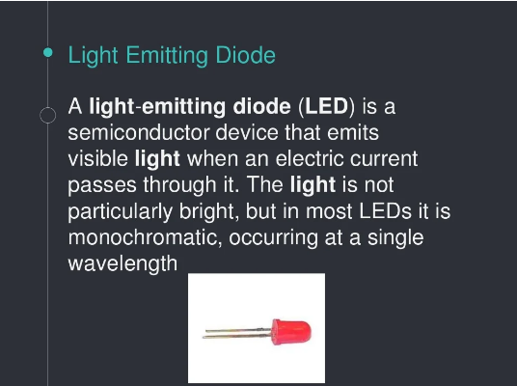

Slide 43
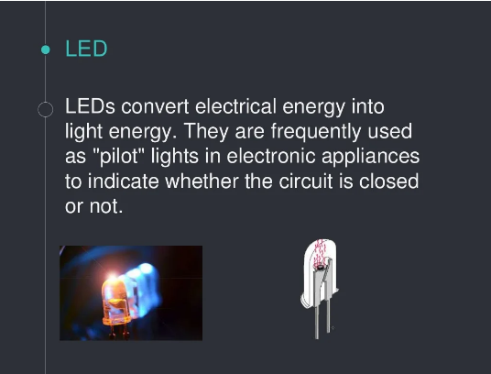

Slide 44
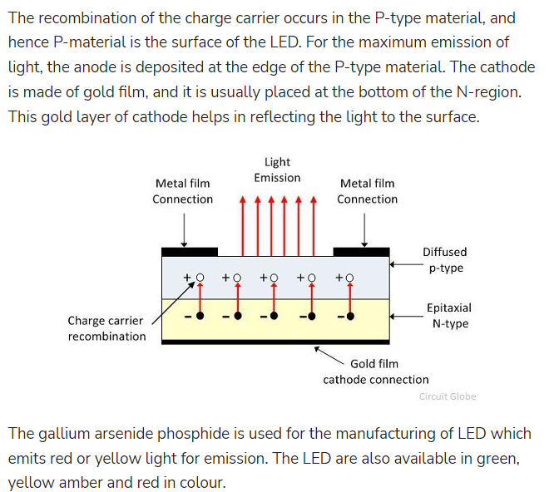

Slide 45
Working of LED
A light emitting diode (LED) is a forward biased p-n junction diode That emits visible light when energized.
LED work on the phenomenon of electroluminescence. On passing a current through the diode, minority charge carriers and majority charge carriers recombine at the junction.
On recombination, energy is released in the form of photons.
The colour of light emitted depends on the semiconducting material used.

Slide 46
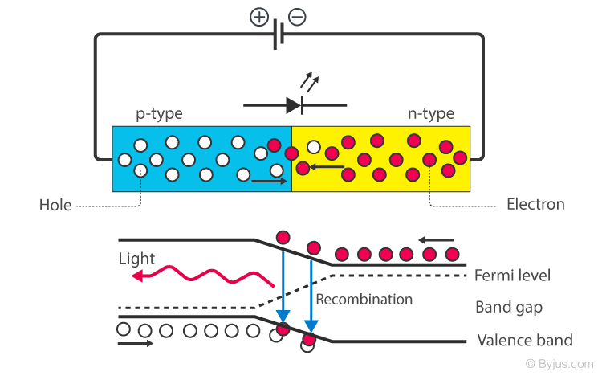

Slide 47
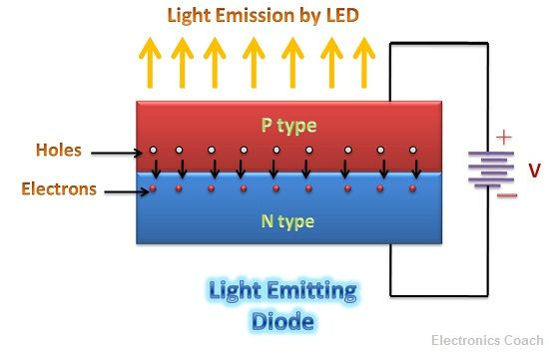

Slide 48
